Slide 1

PRINCIPLES OF MANAGEMENT

Slide 2
Course content
MANAGEMENT ( 3rd Module ) [ 1 credit ]
1 | Introduction to Management | 01
2 | Need for Management | 02
3 | Various types of Management styles | 03
4 | Vision, Mission, Corporate Objectives, various types of Corporate Strategies including Generic Product-Market Grid strategies for CM & IM or B2C & B2B. | 02
5 | Business level strategies and its importance | 02
6 | Functional level strategies and its importance in creating value for the customer.
7 | Communication Process | 02
8 | Development of cases by students; Corporate Planning and implementation requirements. | 02
 | Total : | 14 hrs.

Slide 3
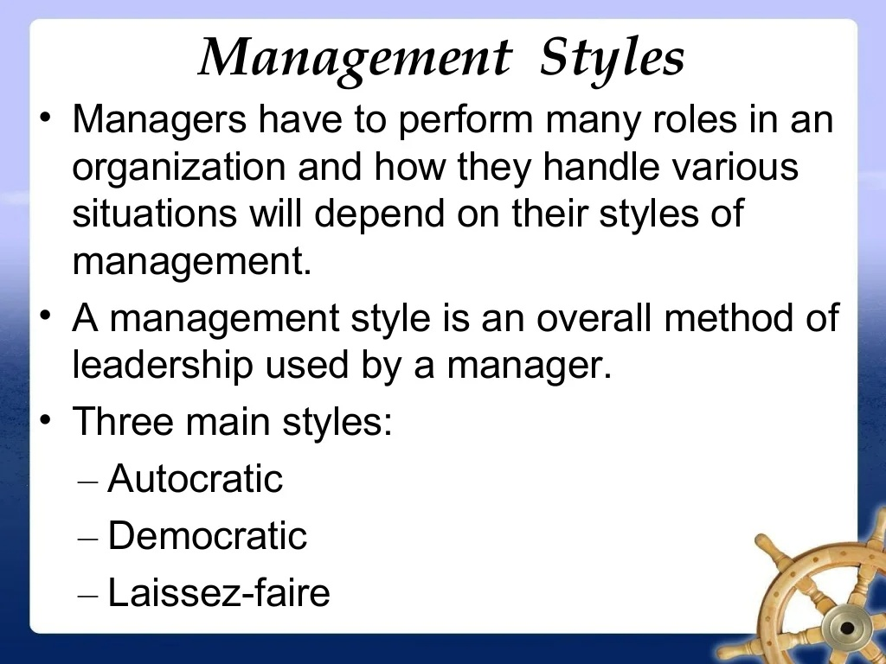

Slide 4
Autocratic management, also known as authoritarian or directive management, is a leadership style where a single individual, typically the manager or leader, holds significant decision-making power and exercises control over the team or organization. In an autocratic management style, the leader makes decisions without seeking much input or feedback from subordinates.

Slide 5
Key characteristics of autocratic management include:
Centralized Decision-Making: The leader makes decisions independently and does not delegate decision-making authority to others in the team.
Limited Input from Team Members: Team members have little to no involvement in the decision-making process. The leader may provide instructions or guidelines without soliciting input or suggestions from others.
Clear Hierarchy: There is a clear hierarchy, and the leader is often seen as the sole authority figure. Subordinates are expected to follow instructions without questioning or challenging the decisions made by the leader.
Swift Decision-Making: Autocratic leaders can make decisions quickly, which can be advantageous in situations that require immediate action or a decisive response.
Strict Control: The leader exercises a high level of control over the work processes, methods, and outcomes. This control is intended to ensure that tasks are completed according to the leader's specifications.
Autocratic management can be effective in certain situations, such as emergency scenarios or environments where quick decisions are crucial. However, it may also lead to reduced morale, lack of employee engagement, and limited innovation if team members feel disempowered or undervalued. In modern management practices, many organizations strive to incorporate more participative and collaborative approaches, recognizing the benefits of involving employees in decision-making processes.

Slide 6
Autocratic Management:
Example: In a highly structured manufacturing plant, the production manager makes all decisions without consulting the team. The manager dictates the workflow, sets production targets, and expects employees to follow instructions without providing much room for input or feedback. This style can be effective in situations where quick decisions are needed or when there is a need for strict control over processes.

Slide 7
Democratic management
Also known as participative or inclusive management, is a leadership style in which decision-making is shared among the leader and the team members. In a democratic management approach, the leader encourages input, feedback, and collaboration from employees before making decisions. This style aims to create a more inclusive and engaging work environment, fostering a sense of ownership and commitment among team members.

Slide 8
Key characteristics of democratic management include:
Collaborative Decision-Making: The leader involves team members in the decision-making process, seeking their input and opinions before making important choices. This approach can lead to more well-rounded and informed decisions.
Open Communication: There is a focus on transparent and open communication within the team. Team members are encouraged to express their ideas, concerns, and suggestions without fear of reprisal.
Empowerment: Democratic leaders empower employees by giving them a sense of ownership and responsibility for their work. This can lead to increased motivation, job satisfaction, and a higher level of engagement.
Team Involvement: Decisions are often made collectively, and the team plays a significant role in setting goals, defining strategies, and problem-solving. This can lead to a more diverse range of perspectives and innovative solutions.
Flat Organizational Structure: Democratic management is often associated with a flatter organizational structure, where there is less emphasis on hierarchy and more emphasis on collaboration among team members.

Slide 9
Example: In a software development team, the project manager holds regular meetings to discuss project goals, timelines, and challenges with the entire team. Decisions are made collectively, with team members having the opportunity to voice their opinions and contribute ideas. The manager facilitates discussions and aims to reach a consensus, fostering a collaborative and inclusive work environment.
While democratic management can enhance employee morale and creativity, it may not be suitable for all situations. It can sometimes be time-consuming, especially when consensus is challenging to achieve, and may not be as effective in urgent or crises. Striking the right balance between involving team members in decision-making and maintaining efficiency is crucial for the success of a democratic management style.

Slide 10
Laissez-faire management
Also known as hands-off or delegative management, is a leadership style where leaders provide minimal guidance or direction to their team members. In this approach, leaders delegate tasks and decision-making authority to employees, allowing them a high degree of autonomy in how they approach and complete their work. The term "laissez-faire" is French for "let it be" or "leave it alone," reflecting the philosophy of minimal interference by leaders.
While laissez-faire management can be effective in certain situations, it may not work well in all contexts. It requires a team of highly skilled and self-motivated individuals who can thrive with minimal guidance. In situations where employees require more direction, support, or structure, a laissez-faire approach may lead to confusion or a lack of productivity. Successful implementation of this management style often depends on the nature of the work, the team's capabilities, and the organizational culture.

Slide 11
Key characteristics of laissez-faire management include:
Minimal Direct Supervision: Laissez-faire leaders provide little direct oversight or supervision. They trust their team members to manage their work and make decisions without constant intervention.
Freedom and Autonomy: Team members have a significant degree of freedom and autonomy in their roles. They are responsible for setting their own goals, making decisions, and managing their work processes.
Limited Structure: This management style often involves a more relaxed or flexible organizational structure. There may be fewer rules and procedures compared to more structured management approaches.
Hands-Off Approach: Laissez-faire leaders typically do not micromanage. Instead, they allow employees to take the lead, offering guidance when needed but otherwise letting them work independently.
Emphasis on Creativity and Innovation: The autonomy provided by laissez-faire management can encourage creativity and innovation within the team. Team members may feel more empowered to explore new ideas and approaches.

Slide 12
Example: In a creative design agency, the team lead adopts a laissez-faire approach, allowing team members the freedom to choose their own projects and work independently. The manager provides resources and support but does not interfere with the day-to-day decision-making of the team. This style is suitable for creative and self-motivated teams where individuals prefer autonomy and flexibility in their work.

Slide 13
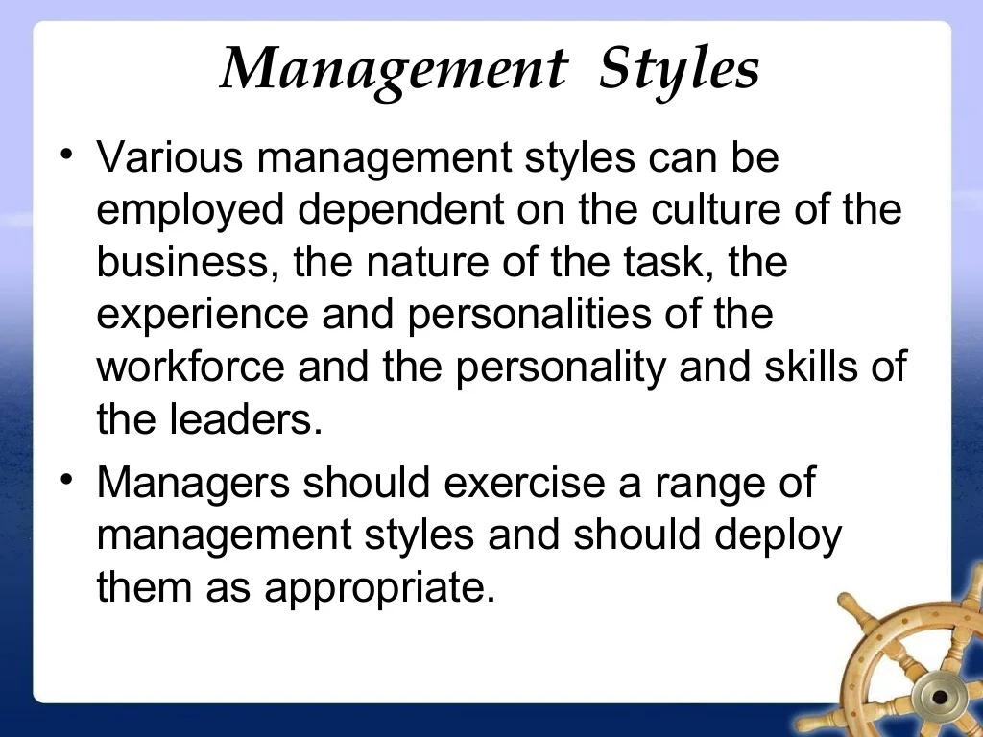

Slide 14
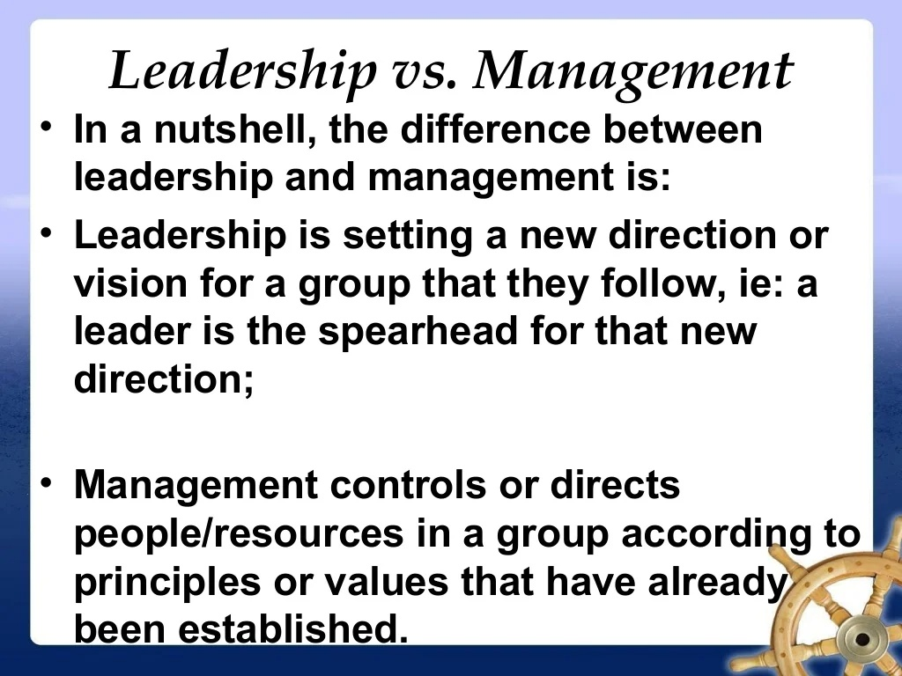

Slide 15
Focus on People vs. Tasks:
  Leadership: Leaders often focus on inspiring and motivating people, fostering a shared vision, and encouraging personal and professional growth. Leadership is more people-oriented and involves influencing others to achieve a common goal.
  Management: Managers, on the other hand, are typically concerned with tasks, processes, and the efficient execution of plans. Management is often associated with controlling resources, implementing strategies, and ensuring that organizational objectives are met.
Vision and Inspiration:
  Leadership: Leaders are often visionary and inspire others by providing a compelling and inspiring vision for the future. They help create a sense of purpose and direction for the team or organization.
  Management: Managers are more focused on executing the established plans and ensuring that tasks are completed efficiently. They may not always be involved in setting the broader vision but are responsible for implementing and achieving specific objectives.
Change and Innovation:
  Leadership: Leaders are often catalysts for change and innovation. They encourage creativity, embrace new ideas, and guide the organization or team through periods of transformation.
  Management: Managers are typically more concerned with maintaining stability, organizing resources, and ensuring that established processes are followed. While they may implement changes, their primary focus is often on efficiency and effectiveness within existing structures.

Slide 16
4. Relationships vs. Authority:
  Leadership: Leaders often build relationships based on trust, influence, and inspiration. Leadership is not necessarily tied to formal authority; individuals can be leaders regardless of their hierarchical position.
  Management: Managers typically derive authority from their formal positions within an organizational hierarchy. Their role involves directing and coordinating the work of others to achieve specific objectives.
5. Long-Term vs. Short-Term Focus:
  Leadership: Leadership tends to have a long-term focus, emphasizing the big picture and the organization's future direction. Leaders may be more willing to take calculated risks in pursuit of long-term goals.
  Management: Management often involves a more short-term focus, ensuring that day-to-day operations run smoothly and that immediate goals are achieved efficiently.
While these differences exist, it's important to note that effective leaders often need management skills, and successful managers often exhibit leadership qualities. In many situations, the terms "leadership" and "management" are used interchangeably, and individuals in leadership roles may need to balance both aspects to achieve overall success in their roles.

Slide 17
Leadership

Slide 18
Leadership
Leadership
The ability to influence a group toward the achievement of a vision or set of goals.

Slide 19
Leadership theories
Trait theories of leadership Theories that consider personal qualities and characteristics that differentiate leaders from non-leaders.
Example: Charisma as a Leadership Trait
Trait theory suggests that individuals with charismatic qualities are more likely to emerge as leaders and are perceived as effective leaders. Charisma involves the ability to inspire and influence others through a compelling and magnetic personality. Charismatic leaders often possess the following traits:
Visionary Outlook
Confidence
Effective Communication
Expressiveness
Empathy

Slide 20
An example of a leader often associated with charisma is Steve Jobs, the co-founder of Apple Inc. Jobs was known for his compelling vision, persuasive communication style, and ability to inspire his team to achieve ambitious goals. His charismatic leadership played a significant role in Apple's success and the development of innovative products.
It's important to note that trait theories have faced criticism for oversimplifying leadership and neglecting situational and contextual factors. Many contemporary leadership theories incorporate a combination of traits, behaviors, and situational factors to provide a more comprehensive understanding of effective leadership.

Slide 21
Leadership theories
Behavioral Theories of leadership proposing that specific
behaviors differentiate leaders from non-leaders.
Ohio state studies proposed 2 leadership behavior described by employees are initiating structure and consideration.
Initiating structure: The extent to which a leader is likely to define and structure his or her role and those of subordinates in the search for goal attainment.
Consideration The extent to which a leader is likely to have job relationships characterized by mutual trust, respect for subordinates’ ideas, and regard for their feelings.

Slide 22
Example: Team Project in a Software Development Company
Imagine a software development team working on a critical project. The team is led by two different managers, each demonstrating distinct leadership behaviors.
Initiating Structure:
  Scenario: Manager A is high on initiating structure. They believe in clearly defining roles, setting specific tasks and deadlines, and providing detailed instructions on how the project should proceed. Manager A organizes regular team meetings to discuss project milestones, allocates responsibilities, and closely monitors progress through structured reports.
  Impact: The team members under Manager A have a clear understanding of their roles and the overall project structure. There is a sense of order and efficiency in the workflow. However, Manager A's leadership style may also be perceived as rigid, and some team members might feel micromanaged.
Consideration:
  Scenario: Manager B is high on consideration. They value building positive relationships with team members. Manager B is approachable, listens actively to team members' ideas and concerns, and fosters an open and collaborative environment. Manager B encourages team members to share their thoughts, provides positive feedback, and considers individual preferences and feelings when making decisions.
  Impact: The team members under Manager B feel a sense of trust and mutual respect. There is a positive and supportive team culture, and employees feel comfortable sharing their ideas. However, there might be challenges in terms of maintaining strict project timelines, and some team members may desire more explicit guidance.
These scenarios illustrate the contrasting behaviors associated with initiating structure and consideration. Effective leadership often involves finding a balance between the two dimensions, and adapting the leadership style to the needs of the situation and the team. The Ohio State Studies, along with similar behavioral theories, emphasize that successful leaders can display a combination of initiating structure and consideration depending on the context and the individuals involved.

Slide 23
Leadership theories
Michigan group identified two behavioral types: the employee-oriented Leader and the production-oriented leader
Employee-oriented leader A leader who emphasizes interpersonal relations, takes a personal interest in the needs of employees, and accepts individual differences among members.
Production-oriented leader A leader who emphasizes technical or task aspects of the job.

Slide 24
Example: Manufacturing Plant Management
Employee-Oriented Leader (Supervisor A):
  Prioritizes interpersonal relations.
  Takes a personal interest in employees' well-being.
  Fosters a positive work environment with strong team cohesion.
Production-Oriented Leader (Supervisor B):
  Prioritizes technical and task aspects.
  Focuses on efficiency and clear performance expectations.
  Operates within a highly structured and efficient system.
In this scenario, the employee-oriented leader emphasizes team relationships, while the production-oriented leader prioritizes task efficiency. Effective leadership often involves balancing both aspects for a well-rounded and successful team.

Slide 25
Leadership theories
Managerial Grid
Robert Blake and Jane Mouton (1960s) proposed a graphic portrayal of leadership styles through a managerial grid (sometimes called leadership grid).
The grid depicted two dimensions of leader behavior, concern for people (accommodating people’s needs and giving them priority) on y-axis and concern for production (keeping tight schedules) on x-axis, with each dimension ranging from low (1) to high (9), thus creating 81 different positions in which the leader’s style may fall.

Slide 26
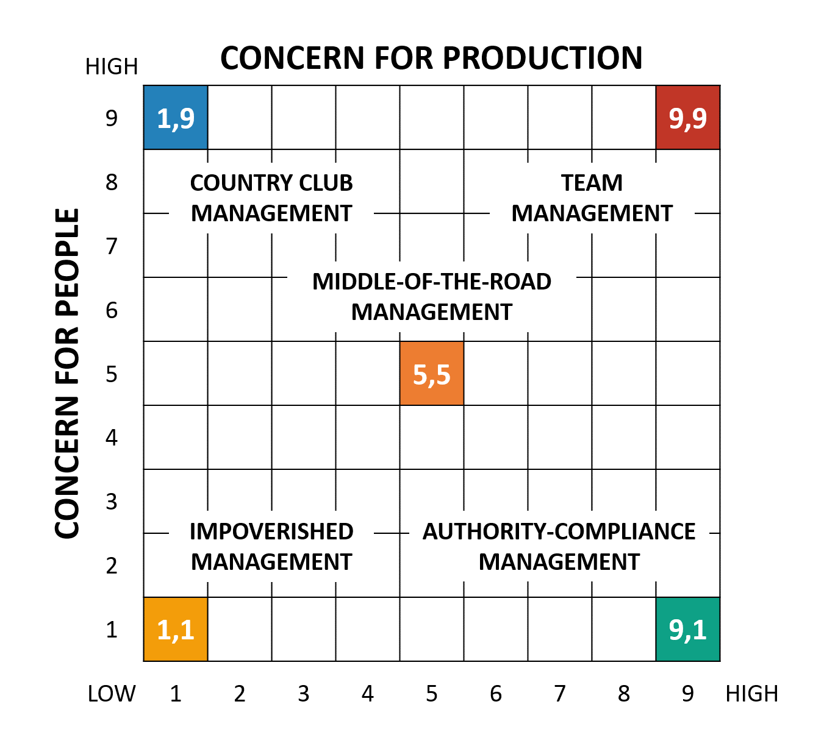
PRODUCE OR PERISH/ TASK MANAGEMENT

Slide 27
Leadership theories
Managerial Grid
The five resulting leadership styles are as follows:
Impoverished Management (1, 1):
Managers with this approach are low on both the dimensions and exercise minimum effort to get the work done from subordinates.
The leader has low concern for employee satisfaction and work deadlines and as a result disharmony and disorganization prevail within the organization.
The leaders are termed ineffective wherein their action is merely aimed at preserving job and seniority.

Slide 28
Leadership theories
Managerial Grid
The five resulting leadership styles are as follows:
Task management (9, 1):
Also called dictatorial or perish style. Here leaders are more concerned about production and have less concern for people.
The employees’ needs are not taken care of and they are simply a means to an end.
The leader believes that efficiency can result only through proper organization of work systems and through elimination of people wherever possible.
Such a style can definitely increase the output of organization in short run but due to the strict policies and procedures, high labour turnover is inevitable.

Slide 29
Leadership theories
Managerial Grid
The five resulting leadership styles are as follows:
Middle-of-the-Road (5, 5):
This is basically a compromising style wherein the leader tries to maintain a balance between goals of company and the needs of people.
The leader does not push the boundaries of achievement resulting in average performance for organization.
Here neither employee nor production needs are fully met.

Slide 30
Leadership theories
Managerial Grid
The five resulting leadership styles are as follows:
Country Club (1, 9):
This is a collegial style characterized by low task and high people orientation where the leader gives thoughtful attention to the needs of people thus providing them with a friendly and comfortable environment.
The leader feels that such a treatment with employees will lead to self-motivation and will find people working hard on their own.
However, a low focus on tasks can hamper production and lead to questionable results.

Slide 31
Leadership theories
Managerial Grid
The five resulting leadership styles are as follows:
Team Management (9, 9):
Characterized by high people and task focus, the style is based on the theory Y of McGregor and has been termed as most effective style according to Blake and Mouton.
The leader feels that empowerment, commitment, trust, and respect are the key elements in creating a team atmosphere which will automatically result in high employee satisfaction and production.

Slide 32
Leadership theories
Situational Leadership Theory (SLT) focuses on the followers. It says successful leadership depends on selecting the right leadership style contingent on the followers’ readiness.
Readiness means the extent to which they are willing and able to accomplish a specific task.

Slide 33
Leadership theories
A leader should choose one of four behaviors depending on follower readiness.
If followers are unable and unwilling to do a task, the leader needs to give clear and specific directions
if they are unable and willing, the leader needs to display high task orientation to compensate for followers’ lack of ability, and high relationship orientation to get them to “buy into” the leader’s desires.
If followers are able and unwilling, the leader needs to use a supportive and participative style
if they are both able and willing, the leader doesn’t need to do much.

Slide 34
Situational Leadership in a School Project
:
Imagine a student group working on a project, and you're the leader. The Situational Leadership Theory suggests that your leadership style should depend on the readiness of your teammates, which is their willingness and ability to do the task.
Unable and Unwilling (Low Readiness):
Example: Some team members are unsure about the project and are not motivated. As the leader, you should give them clear instructions and guidance to help them understand and get started.
Unable but Willing (Moderate Readiness):
Example: Other teammates are willing but lack the skills. In this case, you should be highly focused on explaining tasks (task orientation) and building a good relationship with them to motivate and encourage their efforts.
Able but Unwilling (Moderate Readiness):
Example: Some team members have the skills but are not motivated. Here, you should use a supportive and participative style. Offer assistance, involve them in decision-making, and show support to boost their enthusiasm.
Able and Willing (High Readiness):
Example: A few members are both skilled and motivated. In this situation, you don't need to be overly involved. You can step back a bit and let them take the lead since they are capable and eager.
So, the key idea is that your leadership style should adapt based on how ready and willing your teammates are to accomplish the task. It's about finding the right balance between giving clear directions and providing support and encouragement, depending on the situation.

Slide 35
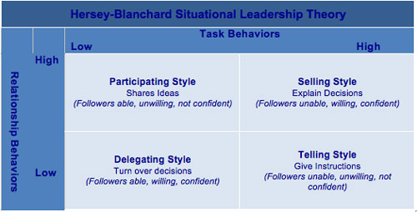
Leadership theories

Slide 36
Leadership theories
Path goal theory
A theory that states that it is the leader’s job to assist followers in attaining their goals and to provide the necessary direction and/or support to ensure that their goals are compatible with the overall objectives of the group or organization.
Developed by Robert House

Slide 37
Leadership theories
Leader–member exchange (LMX) theory
The goal of LMX theory is to explain the effects of leadership on members, teams, and organizations.
According to the theory, leaders form strong trust, emotional, and respect-based relationships with some members of a team, but not with others.
LMX theory claims that leaders do not treat each subordinate the same.

Slide 38
Example of Leader-Member Exchange (LMX) theory
Imagine a team of software developers working under a project manager in a tech company. The project manager forms strong, trust-based relationships with some members of the team who consistently deliver high-quality work, show initiative, and demonstrate reliability. These team members often have open lines of communication with the manager, receive regular feedback and support, and are given opportunities for career development and advancement within the company.
On the other hand, there may be team members who do not share the same level of trust and respect with the manager. These individuals may struggle to meet deadlines, require more supervision and guidance, or have difficulties aligning with the team's goals and values. As a result, the manager may not invest as much time and effort into developing relationships with these team members, leading to a weaker exchange relationship.
This example illustrates how LMX theory suggests that leaders do not treat each subordinate the same way. Instead, they form unique, individualized relationships with each team member based on factors such as performance, attitude, and compatibility. These differential relationships can impact team dynamics, job satisfaction, and ultimately, organizational outcomes.

Slide 39
Leadership theories
Transactional Leadership: Leaders who guide or motivate their followers in the direction of established goals by clarifying role and task requirements.
Managers give employees something they want in exchange for getting something they want.
It posits that workers are not self-motivated and require structure, instruction and monitoring in order to complete tasks correctly and on time.

Slide 40
Example
Imagine a retail manager who uses a transactional leadership style to motivate their sales team. The manager sets clear expectations for the sales associates, outlining specific sales targets, customer service standards, and operational guidelines. In exchange for meeting these goals, the manager offers rewards such as bonuses, commission incentives, or recognition.
The sales associates, in turn, understand that they are expected to meet certain performance metrics to receive these rewards. They are motivated by the tangible benefits offered by the manager and strive to achieve their sales targets and provide excellent customer service to earn those rewards.
In this scenario, the manager provides structure, instruction, and monitoring to ensure that tasks are completed correctly and on time. The transactional exchange between the manager and the sales associates involves the manager providing incentives in exchange for the desired performance from the employees.
Overall, this example illustrates how transactional leadership operates in a real-world setting, where managers guide and motivate their employees toward established goals through a system of rewards and incentives.

Slide 41
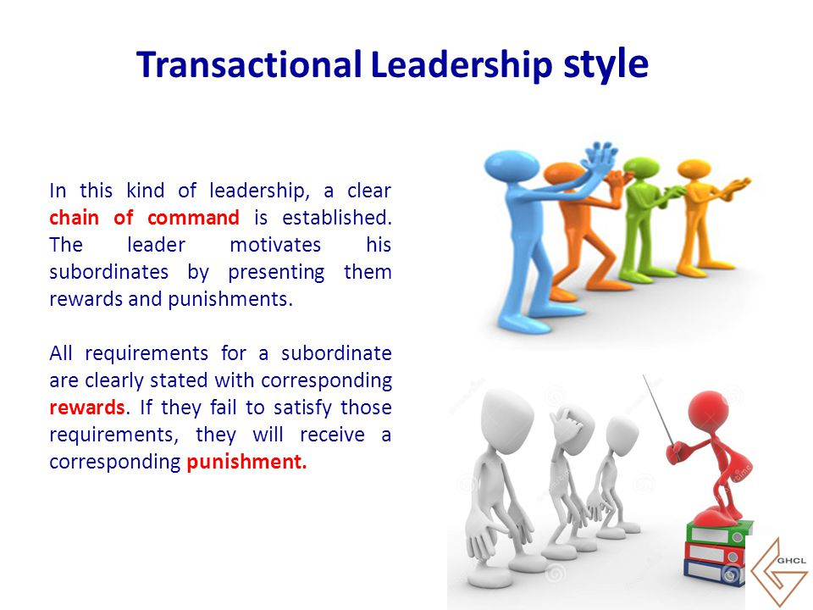
Leadership theories

Slide 42
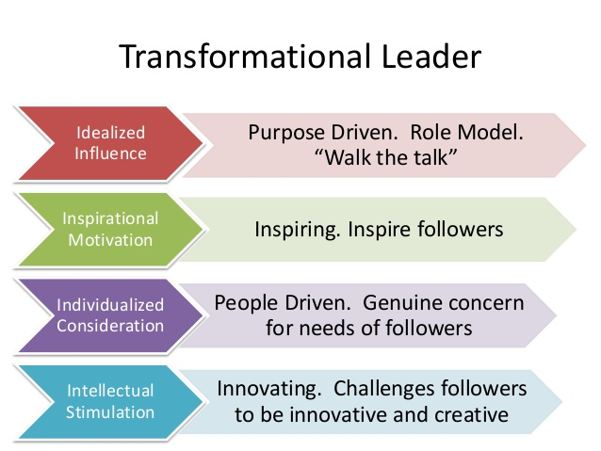
Leadership theories
Transformational Leadership: inspire followers to transcend their self-interests for the good of the organization.
Transformational leaders can have an extraordinary effect on their followers.

Slide 43
Example of transformational leadership
Mahatma Gandhi inspired millions of Indians to transcend their self-interests and work towards the greater good of the nation. Through his vision, charisma, and moral authority, Gandhi motivated people to join the nonviolent civil disobedience movement against British colonial rule.
Gandhi's transformational leadership was characterized by his ability to articulate a compelling vision of independence and social justice, which resonated deeply with the masses. He appealed to people's sense of morality and conscience, urging them to resist oppression peacefully and strive for a more equitable society.
Gandhi's leadership style empowered ordinary individuals to become agents of change and take collective action to challenge injustice. His emphasis on nonviolent resistance and civil disobedience inspired people from all walks of life to join the freedom struggle, regardless of their personal interests or backgrounds.
Under Gandhi's guidance, the Indian independence movement became a mass movement, mobilizing millions of people across the country and ultimately leading to India's independence in 1947. Gandhi's transformational leadership left a lasting legacy, not only in India but also in the global struggle for human rights and social justice.

Slide 44
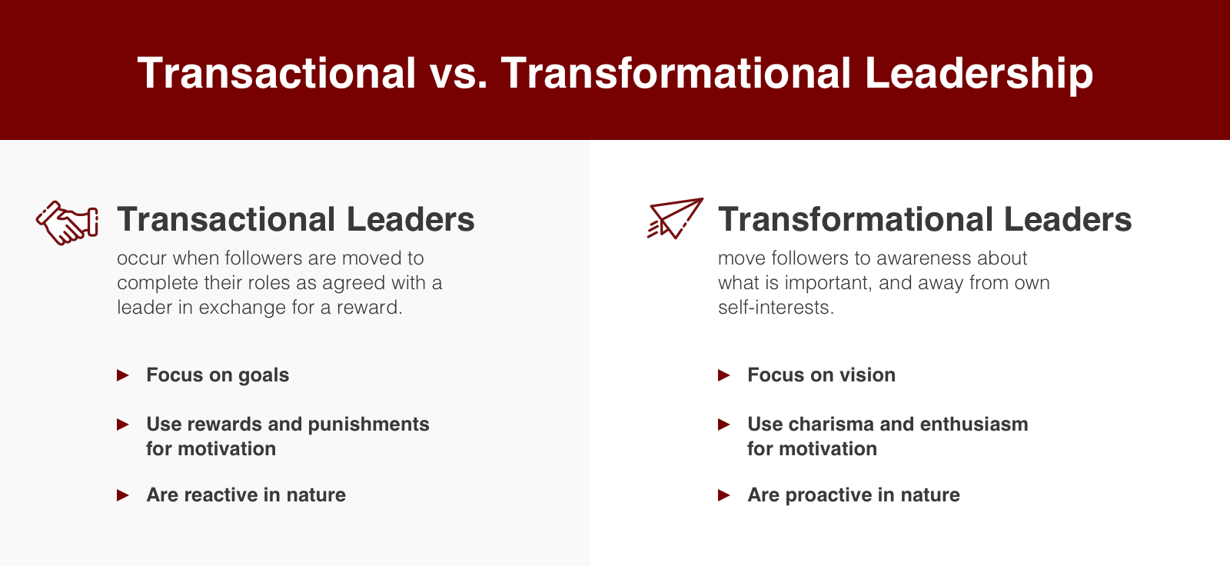

Slide 45
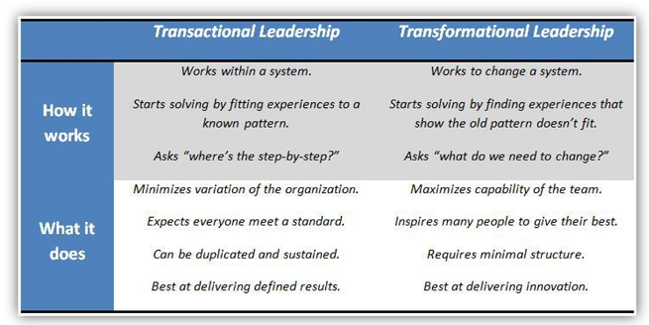

Slide 46
THANK YOU……………..

